Slide 1
Hyperonomy Universal Decentralized Identifier URI Specification (did-uri-spec): DSDG Matrix and $supportedCapabilities https://github.com/mwherman2000/did-uri-spec
v0.24
Michael Herman (@mwherman2000)
Independent Blockchain Architect
mwherman@parallelspace.net

Slide 2
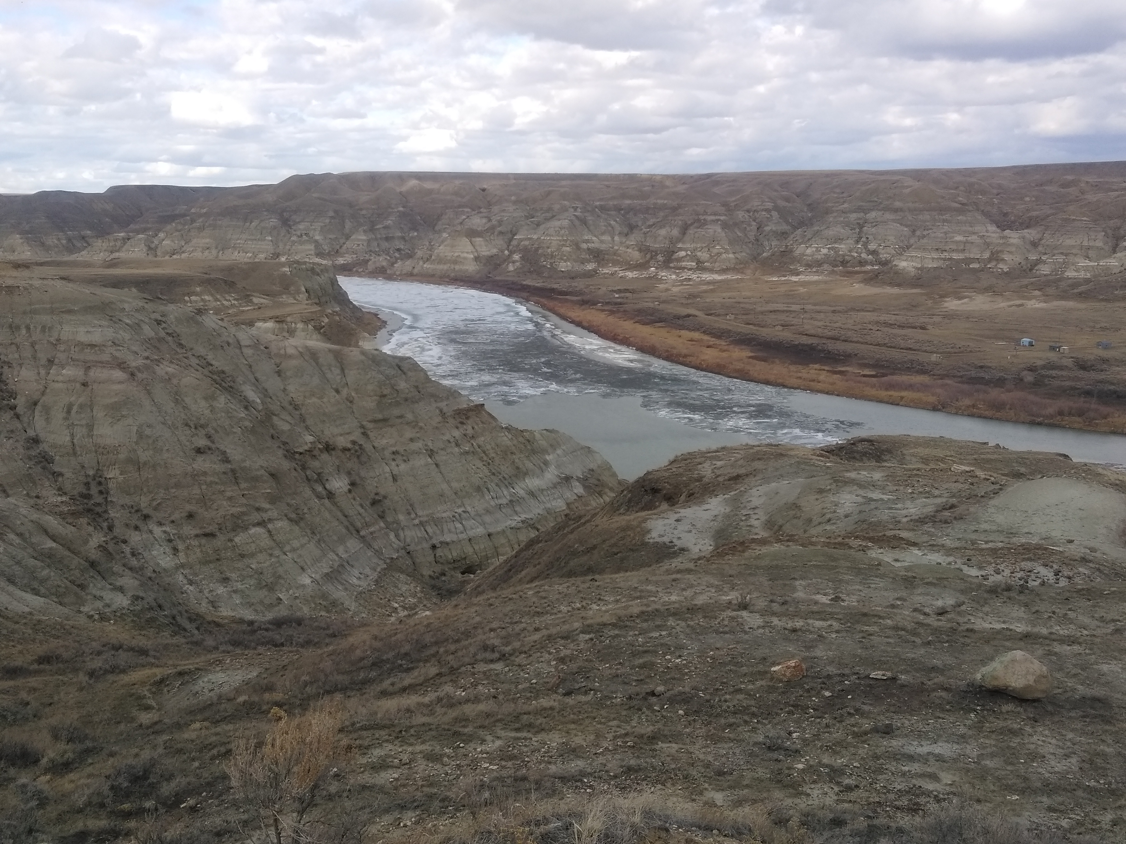
Michael Herman Independent Blockchain Architect Alberta, CANADA
Notes:
My name is Michael Herman and I am an independent blockchain architect. I live on a ranch in Alberta, Canada and
I’ve worked on large, complex, distributed systems in hostile environments for more than 40 years.

Slide 3
Purpose and Audience
Purpose
The purpose of this presentation is:
Describe the 3x3 matrix model for Domain Specific DID Grammars (DSDG Matrix)
Describe how the $supportedCapabilities option is designed to work with the DSDG Matrix
Audience
The primary audience for this presentation is implementors and maintainers of parser software that is compliant with the did-uri-spec including but not limited to:
W3C Decentralized Identifier specification
DID Resolvers and DID Resolution
Agent-to-Agent (A2A) Communications services in the Hyperledger Indy Agent framework

Slide 4
 Background: High-level did-uri-spec User Scenarios
Michael Herman (@mwherman2000)
Independent Blockchain Architect
mwherman@parallelspace.net
2019-04-08

Slide 5
High-level did-uri-spec User Scenarios (Slide 45)
# | did-uri-spec Syntax Patterns | Type of Document Returned
1 | <did> | DID Document
2 | <did>!$selectId="exam_src" | DID Document Fragment
3 | <did>!$serviceId="exam_src" | Remapped Service Endpoint URI/URL
4 | <did>!$contentId="pqrs" | DID Doc Content Fragment
5* | <did>!$attachmentId="abcd" | A2A Message Attachment Fragment
6 | "query": "<did>!$filter='*'" | Array of All Service Agent Feature/Protocol Descriptions
7 | "query": "<did>!$filter='spec/tictactoe/1.*'" | Array of Filtered Service Agent Feature/Protocol Descriptions
8 | <didmethod>!$supportedCapabilities | Array of DID Method Capabilities
9a | did:!$documents / did:xyz:!$documents | Array of DID Documents
9b | did:xyz:!$documents&$top=10&$skip=100 | Batch of DID Documents
9c | did:xyz:!$documents&$filter='has=ServiceEndPoint'&$top=10&$skip=100
9d | did:xyz:!$documents&$filter='version=4'&$top=10&$skip=100
Notes:
* Makes false assumption that each Agent message has a `did` associated with it.

Slide 6
High-level did-uri-spec User Scenarios (Slide 46)
# | did-uri-spec Syntax Patterns | Type of Document Returned
10 | <did>!?$exists | True or False
11 | <did>!?$exists="bops" | True or False
12 | <did>!$type="diddoc" (default type – UC #1) | DID Document
13 | <did>!$type="schema" | Schema Document
14 | <did>!$type="creddef" | Credential Definition Document
15 | <did>!$type="overlay.format" | Format Overlay Document
16 | <did>!$type="node" | VDR Node Document
17 | did:!$type="config.pool" | Pool Configuration Document
18 | did:!$type="perfmon.pool" | Pool Performance Monitoring Doc
19 | did:xyz:!$type="perfmon.didmethod" | DID Method Perf. Monitoring Doc

Slide 7
High-level did-uri-spec User Scenarios (Slide 47)
# | did-uri-spec Syntax Patterns | Type of Doc Returned
20 | Manu Pattern: did:example:12345678:path:blog:/2019-03-01/lunch-in-Barcelona did-uri-spec: did:example:12345678!$path=“blog”/2019-03-01/lunch-in-barcelona Output: https://example.org/2019-03-01/lunch-in-barcelona | Content URI/URL
21 | Manu Pattern: did:<did-method>:<method-specific-id>:path:<service-id>:<service-path> did-uri-spec: did:example:12345678!$serviceId=“exam_src”/stuff/2019-03-01/lunch-in-barcelona Output: https://example.org/stuff/2019-03-01/lunch-in-barcelona | Content URI/URL
22 | Manu Pattern: did:example:schema:hl:z3aq31uzgnZBuWNzUB did-uri-spec: did:example:12345678!$hashlink=“hl:z3aq31uzgnZBuWNzU”&$doctype=“schema” Output: Schema Document | Schema Document

Slide 8
High-level did-uri-spec User Scenarios (Slide 48)
# | did-uri-spec Syntax Patterns | Type of Doc Returned
23 | Manu Pattern: User scenario #20 plus request for version 4 did-uri-spec: did:example:12345678!$path=“blog”&$filter=“version=4”/2019-03-01/lunch-in-barcelona Output: https://example.org/2019-03-01/lunch-in-Barcelona-v4 | Content URI/URL
24 | Manu Pattern: User scenario #23 plus French version of version 4 if available; otherwise return the English version of version 4 did-uri-spec: did:example:12345678!$path=“blog”&$filter=“version=4,lang=‘fr-fr’,’en-us’”/2019-03-01/lunch-in-barcelona Output: https://example.org/fr-fr/2019-03-01/lunch-in-Barcelona-v4 | Content URI/URL

Slide 9
 Background: Domain Specific DID Grammars
Michael Herman (@mwherman2000)
Independent Blockchain Architect
mwherman@parallelspace.net
2019-04-08

Slide 10
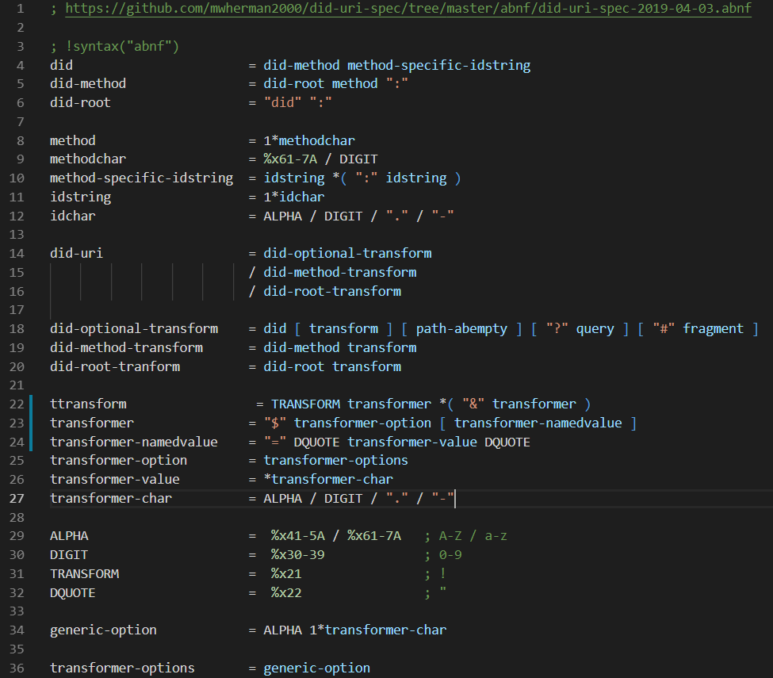

0. MASTER did-uri-spec Grammar
RFC 3986
Compliant
Each of the following 9 Domain Specific DID Grammars are a subset of the Master did-uri-spec grammar

Slide 11
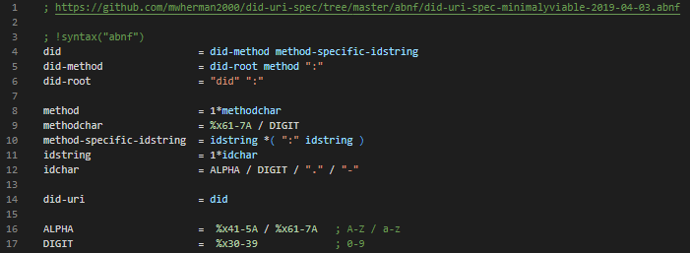
1. Minimally Viable did-uri-spec Grammar did
RFC 3986
Compliant

Slide 12
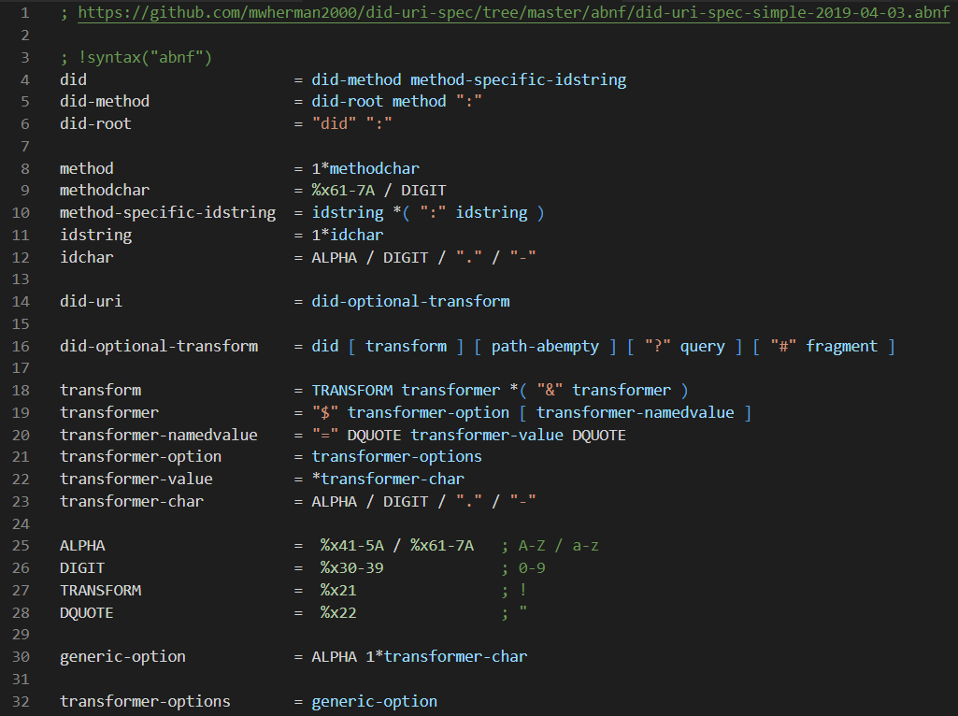
2. Simple did-uri-spec Grammar did
RFC 3986
Compliant

Slide 13
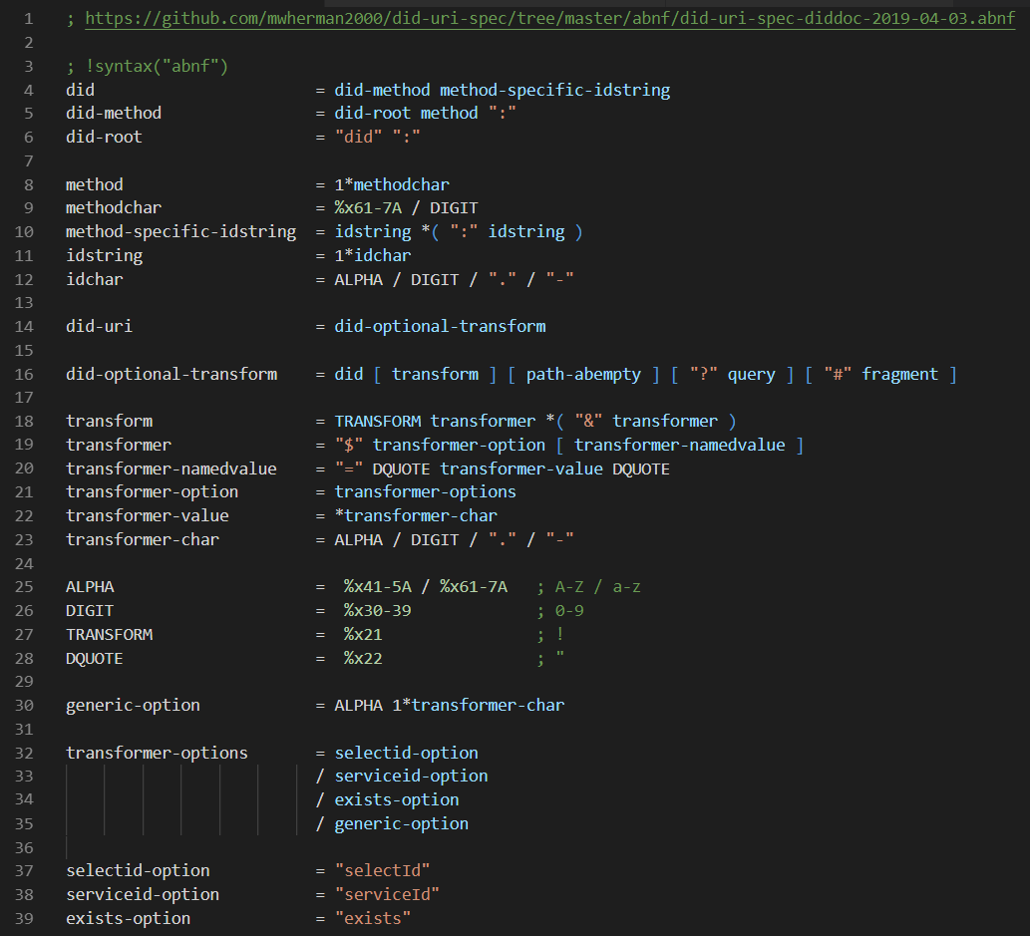
3. DID Document did-uri-spec Grammar did
RFC 3986
Compliant

Slide 14
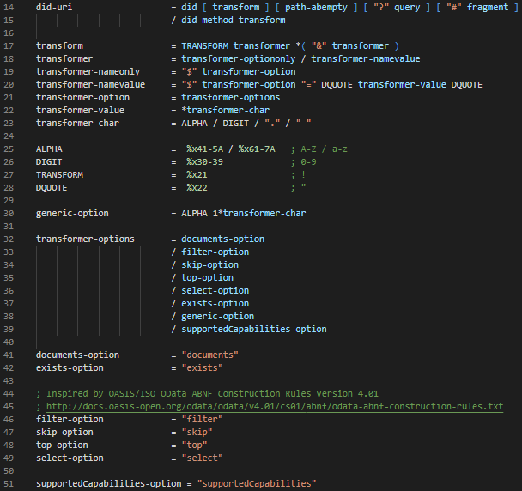
4. DID Document Collections did-uri-spec Grammar did-method
RFC 3986
Compliant

Slide 15
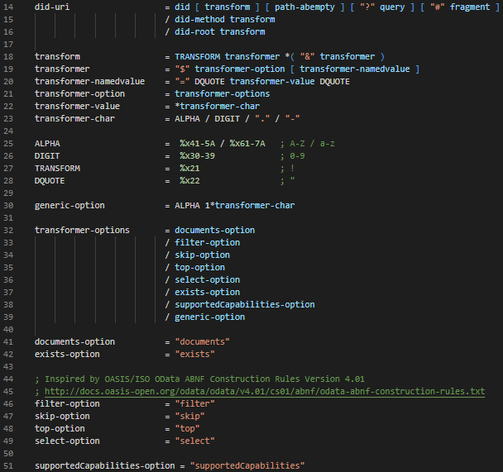
5. DID Document Collections did-uri-spec Grammar did-root
RFC 3986
Compliant

Slide 16
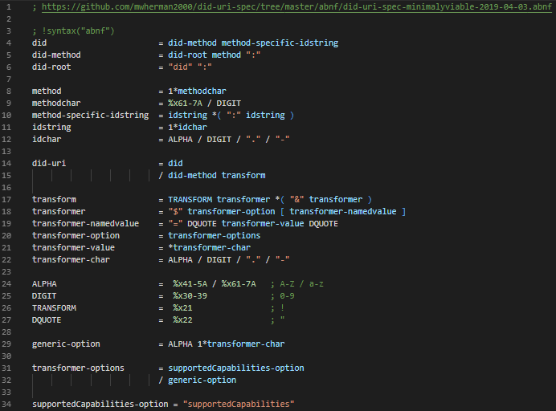
6. Minimally Viable did-uri-spec Grammar with $supported-Capabilities did-method
RFC 3986
Compliant

Slide 17
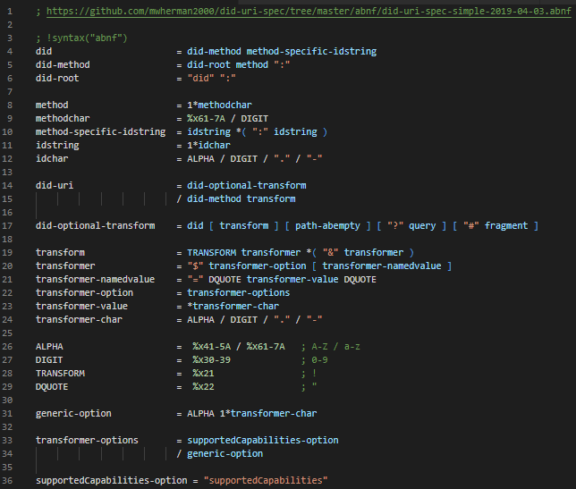
7. Simple did-uri-spec Grammar with $supported-Capabilities did-method
RFC 3986
Compliant

Slide 18
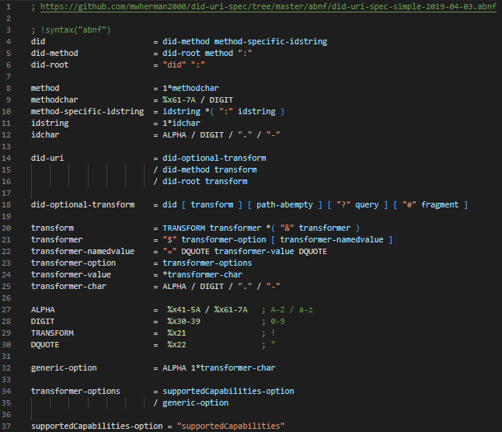
8. Simple did-uri-spec Grammar with $supported-Capabilities did-root
RFC 3986
Compliant

Slide 19
 Domain-Specific DID Grammars Matrix
Michael Herman (@mwherman2000)
Independent Blockchain Architect
mwherman@parallelspace.net
2019-04-08

Slide 20
1. Minimally Viable did-uri-spec Grammar did
RFC 3986
Compliant

Slide 21
0. MASTER did-uri-spec Grammar “All-In” did-uri-spec Grammar
RFC 3986
Compliant

Slide 22
Domain Specific DID Grammar MATRIX
3. DID Document did-uri-spec Grammar | 4. DID Document Collections did-uri-spec Grammar | 5. DID Document Collections did-uri-spec Grammar
2. Simple did-uri-spec Grammar | 7. Simple did-uri-spec Grammar with $supportedCapabilities | 8. Simple did-uri-spec Grammar with $supportedCapabilities
1. Minimally Viable did-uri-spec Grammar | 6. Minimally Viable did-uri-spec Grammar with $supportedCapabilities | 9. N/A
Bounded
Generic
Depth
Minimally
Viable
did
did-method
did-root
Breadth

Slide 23
 Applying DSDG Matrix in Real Life
Michael Herman (@mwherman2000)
Independent Blockchain Architect
mwherman@parallelspace.net
2019-04-08

Slide 24
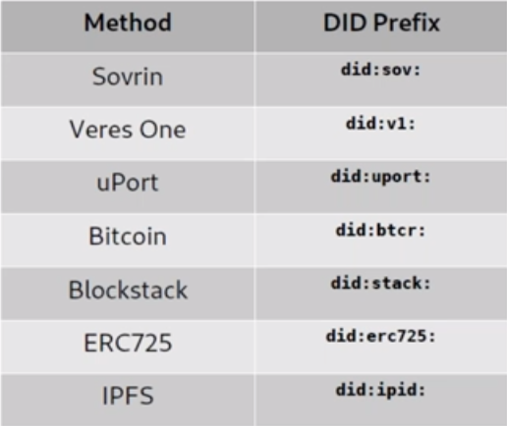
common DID Methods and Schemes
DID Method
DID Scheme
3. DID Document did-uri-spec Grammar $supportedCapabilities returns the DID associated with the
DID Document did-uri-spec Grammar

Slide 25
 Wrapping UP…
Michael Herman (@mwherman2000)
Independent Blockchain Architect
mwherman@parallelspace.net
2019-04-08

Slide 26
Next Steps
Continue to grow and validate the number of higher-level DID user scenarios and, more specifically, lower-level did-uri-spec use cases with:
Diverse DID communities
Diverse DID higher-level DID user scenarios
More Indy HIPES
IPID, etc.
Build and test did-uri grammar
Using the lower-level did-uri-spec use cases as a test cases
Continue to grow the outreach (awareness, knowledge and understanding) of the did-uri-spec specification amongst:
Diverse DID communities
Diverse DID higher-level DID user scenario specific scenarios
More Indy HIPES
IPID, etc.

Slide 27
 QUESTIONS?
Michael Herman (@mwherman2000)
Independent Blockchain Architect
mwherman@parallelspace.net
2019-04-08

Slide 28
Hyperonomy Universal Decentralized Identifier URI Specification (did-uri-spec)
2019-04-08

